Slide 1
Using Government Documents to enhance your NHD search
Sarah Dobransky
Cleveland Public Library

Slide 2

What is National History Day?

Slide 3

2017-2018 Theme
Paper
Exhibit
Performance
Documentary (and Process Paper)
Website

Slide 4

Example – website http://22570218.weebly.com/home.html

Slide 5
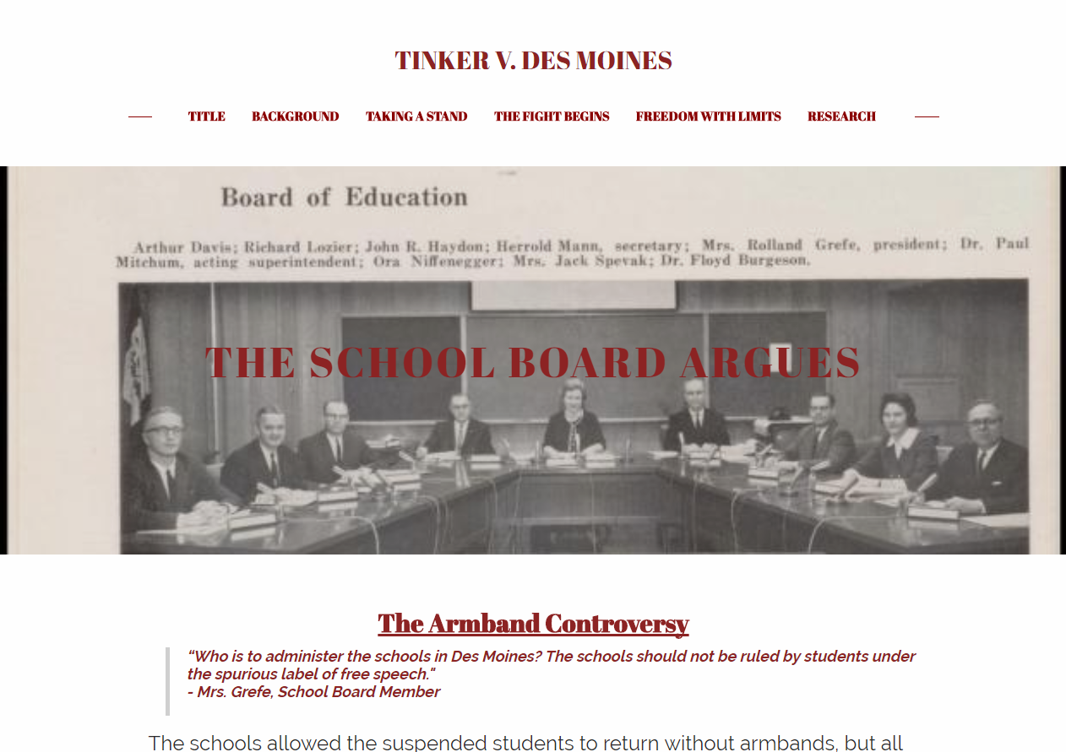

Slide 6
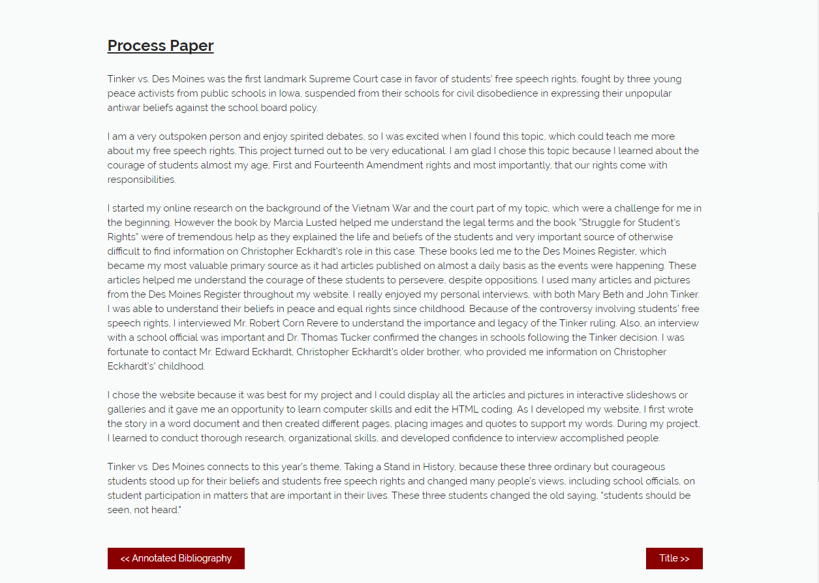

Slide 7

Example – website http://17854214.weebly.com/

Slide 8
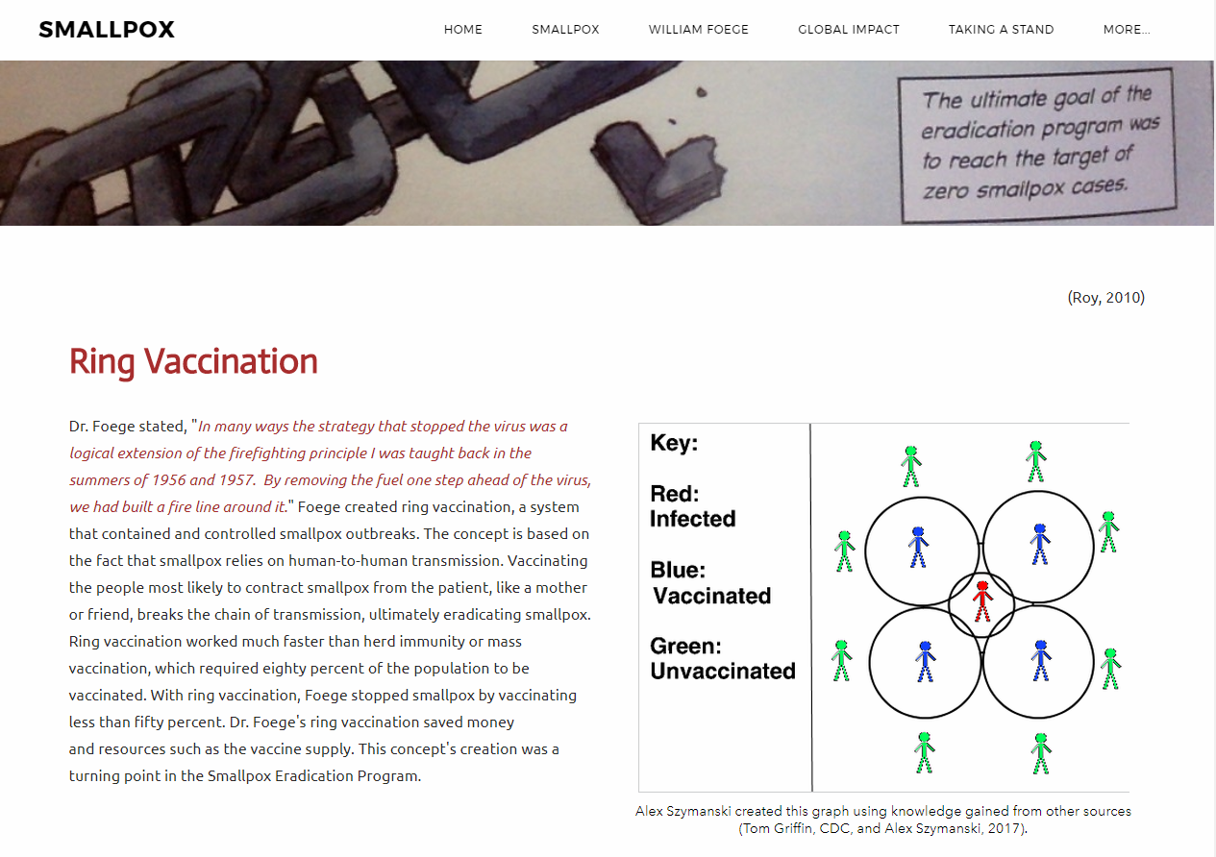

Slide 9
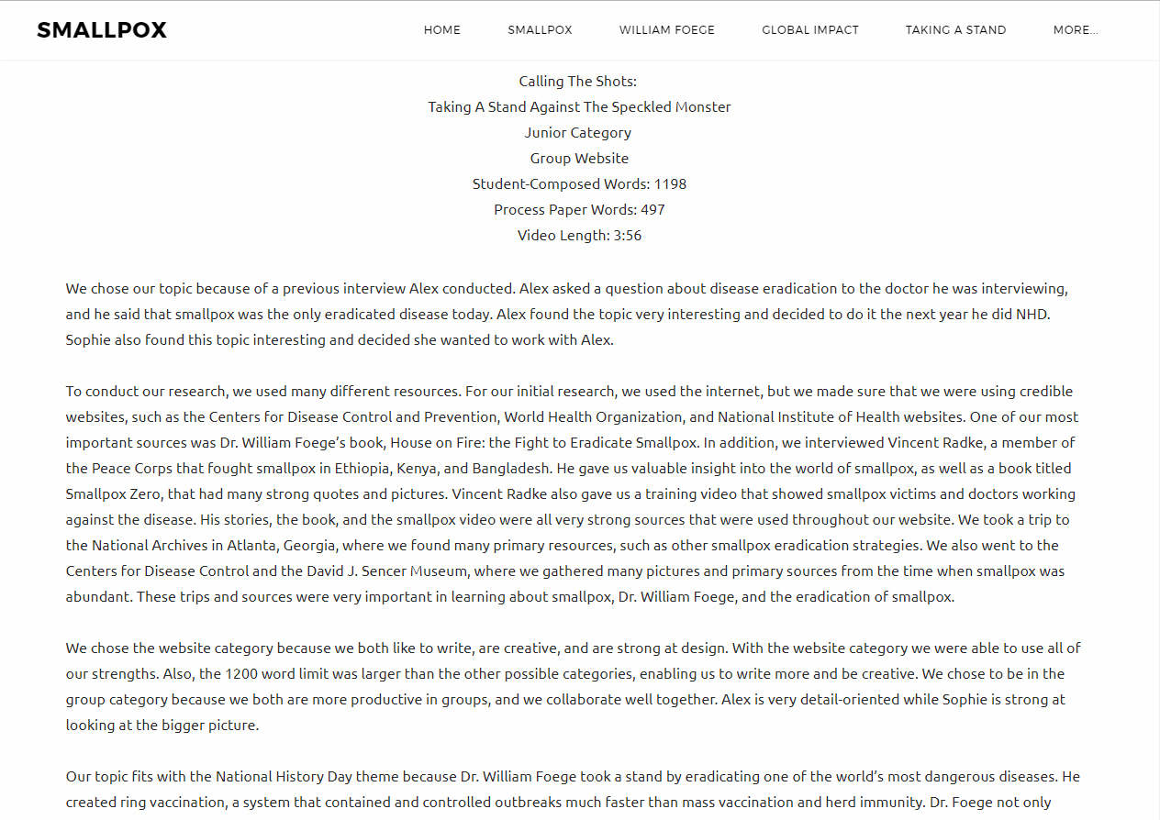

Slide 10
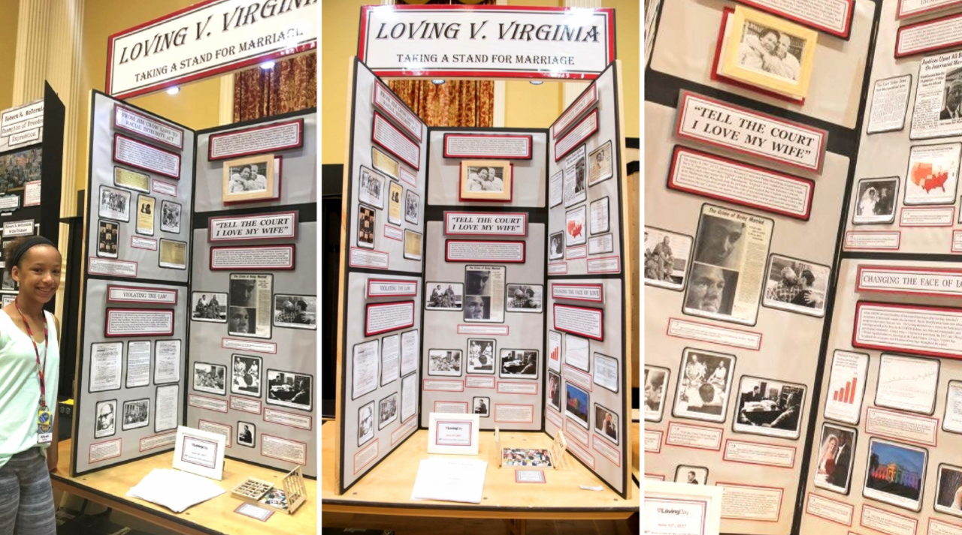
Example – Exhibit 3rd place

Slide 11
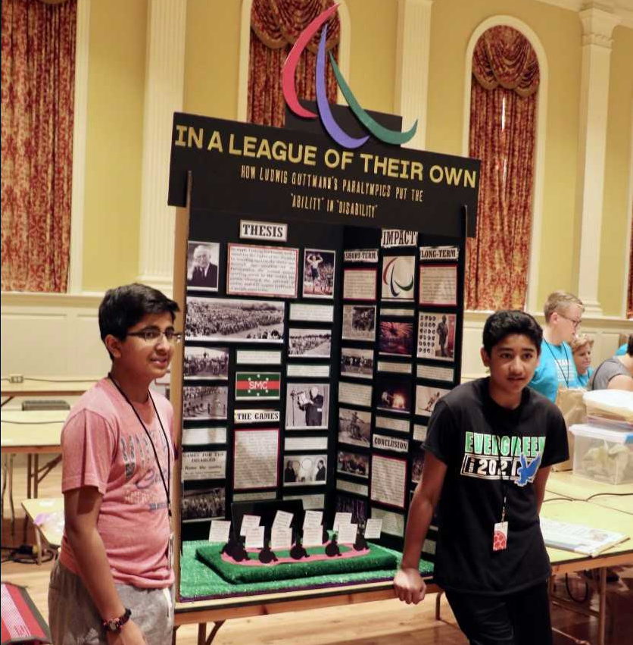
Example – Exhibit 2nd place

Slide 12
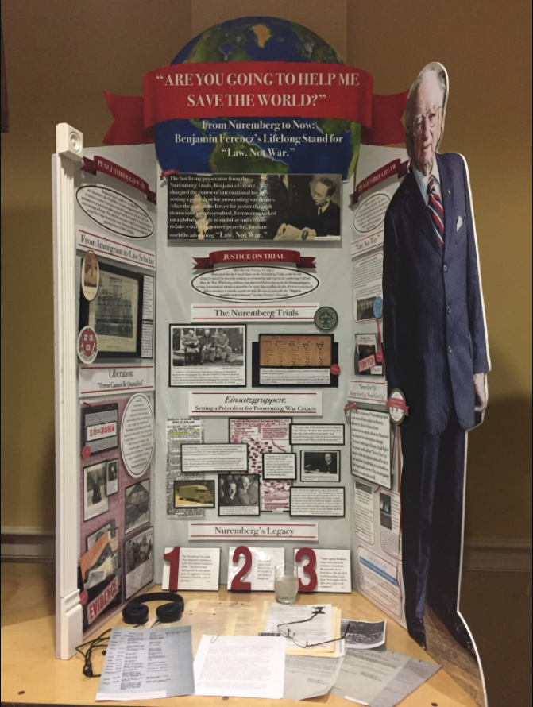
Example – Exhibit 1st place

Slide 13
Benefits of using gov docs
Primary resources
Follow the historic path of America’s most influential figures
See how actions led to change through famous legislation in Congress and the Court System
Get access to electronic copies of letters, photographs, and more without copyright restrictions
Out-of-the-box approach to history research

Slide 14
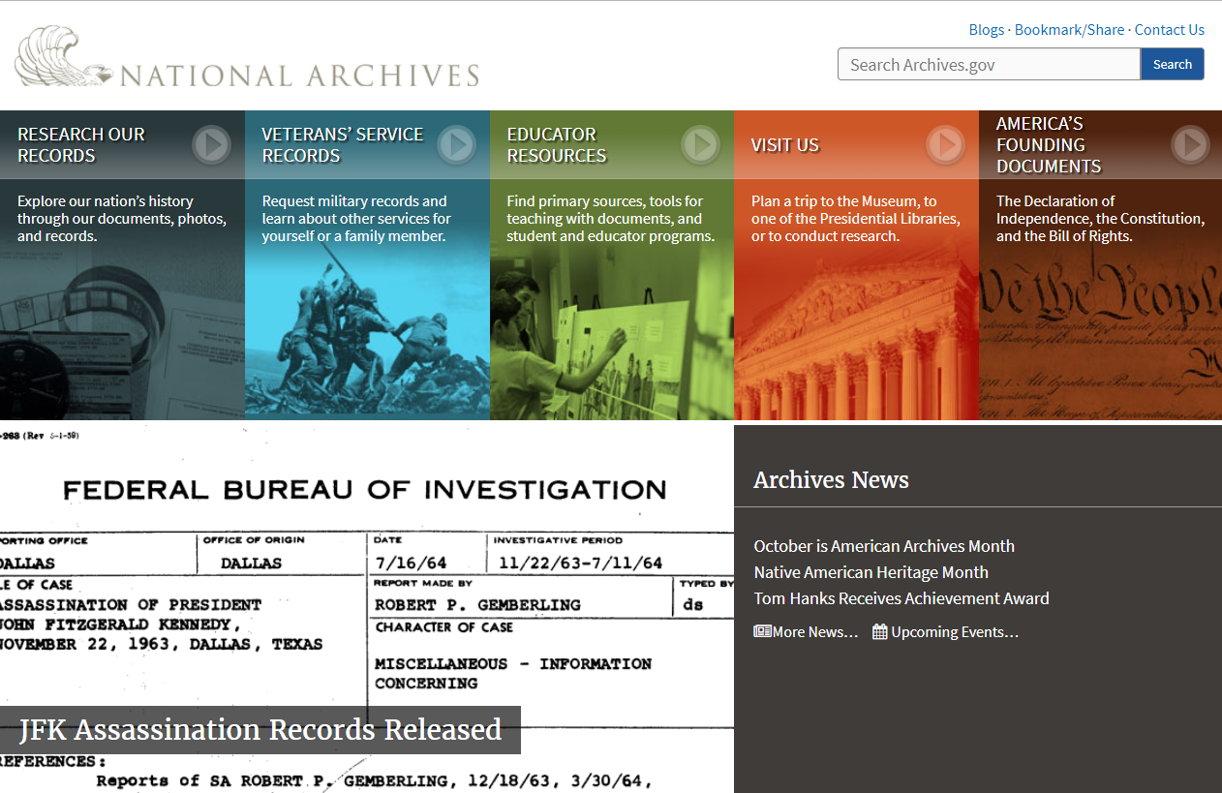
Suggested Resources
Archives.gov

Slide 15
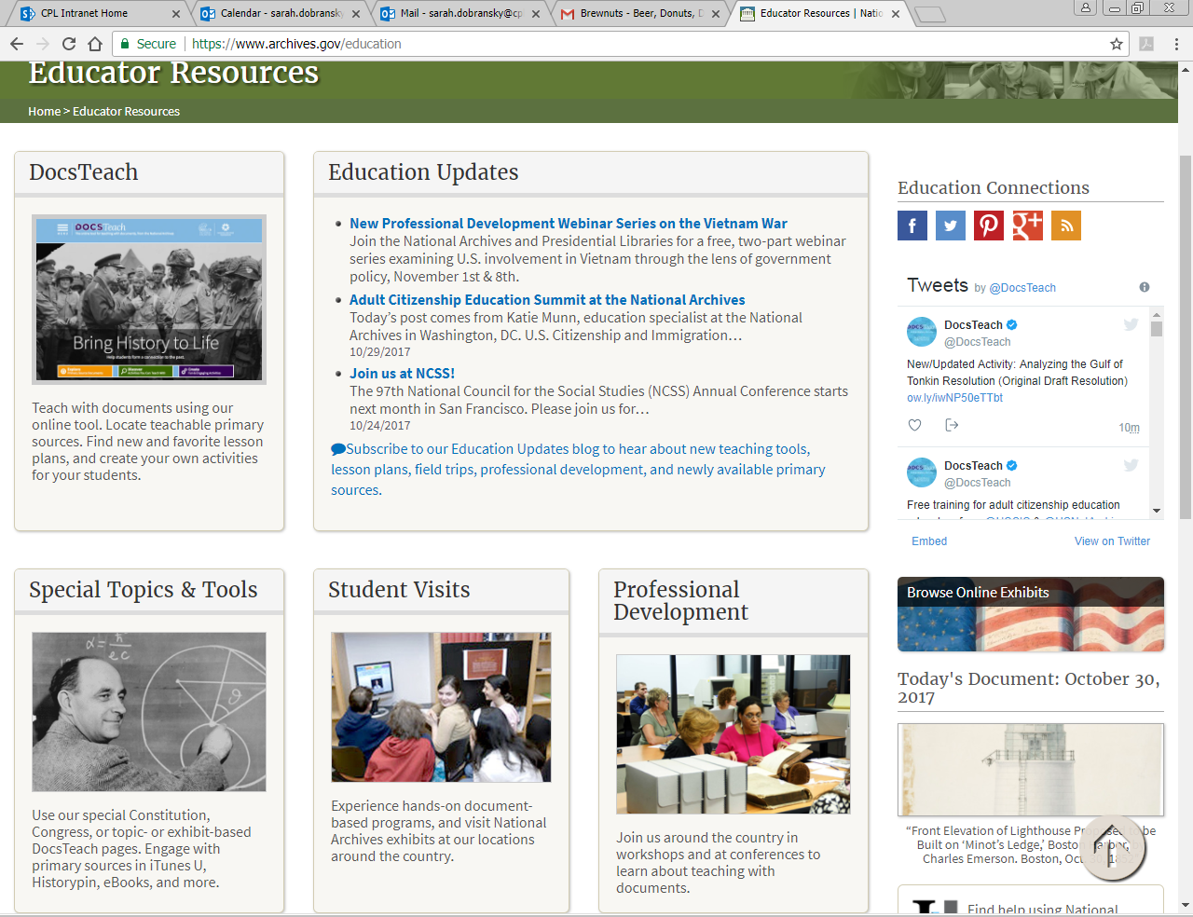

Slide 16
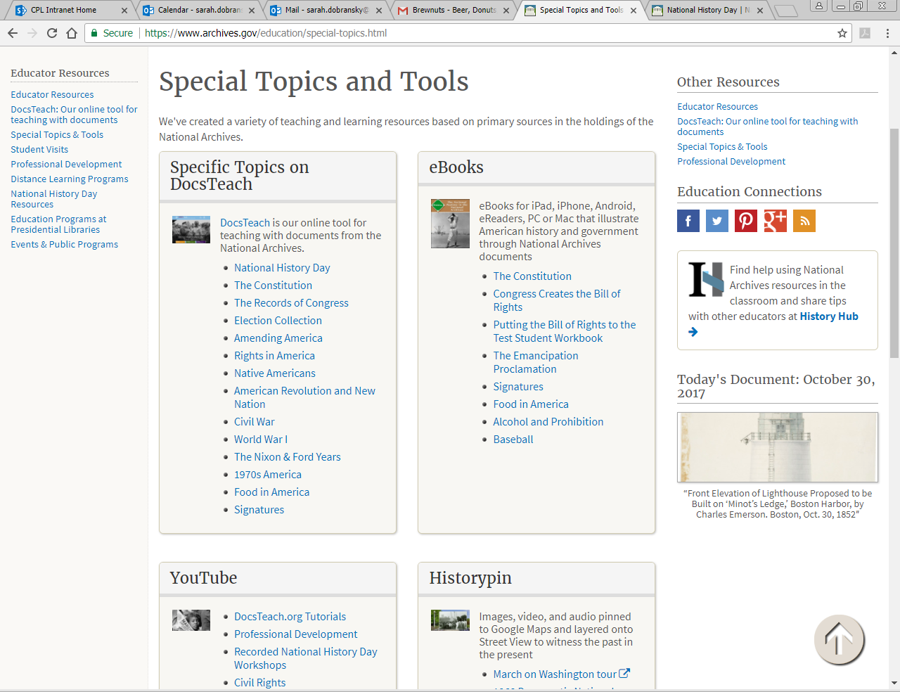
NARA: Special Topics and Tools

Slide 17

Docs Teach
Notes:
Combined effort of the National Archives (government) and the National Archives Foundation (independent nonprofit)
You can access thousands of primary resources, including original documents and photographs.

Slide 18
Docs Teach Historical Eras
Revolution and the New Nation (1754-1820s)
Expansion and Reform (1801-1861)
Civil War and Reconstruction (1850-1877)
The Development of the Industrial United States (1870-1900)
The Emergence of Modern America (1890-1930)
The Great Depression and World War II (1929-1945)
Postwar United States (1945 to early 1970s)
Contemporary United States (1968 to the present)

Slide 19
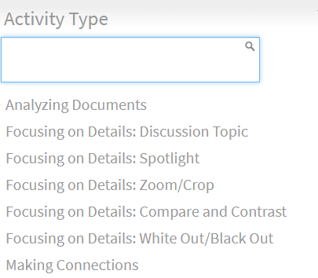
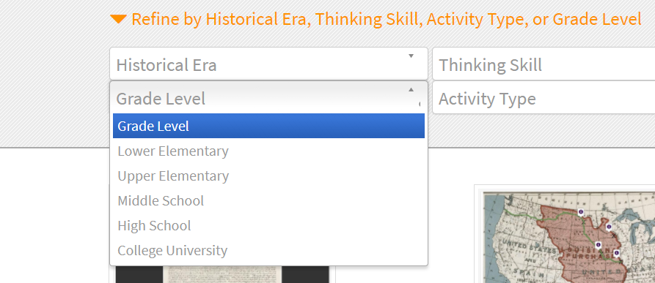
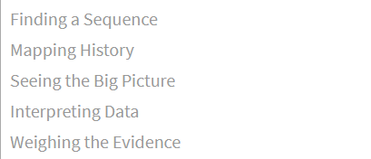
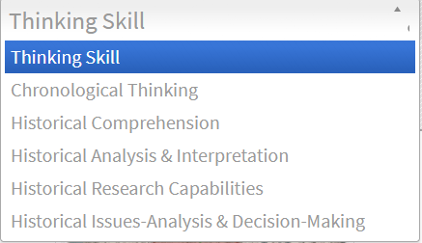
For teachers

Slide 20
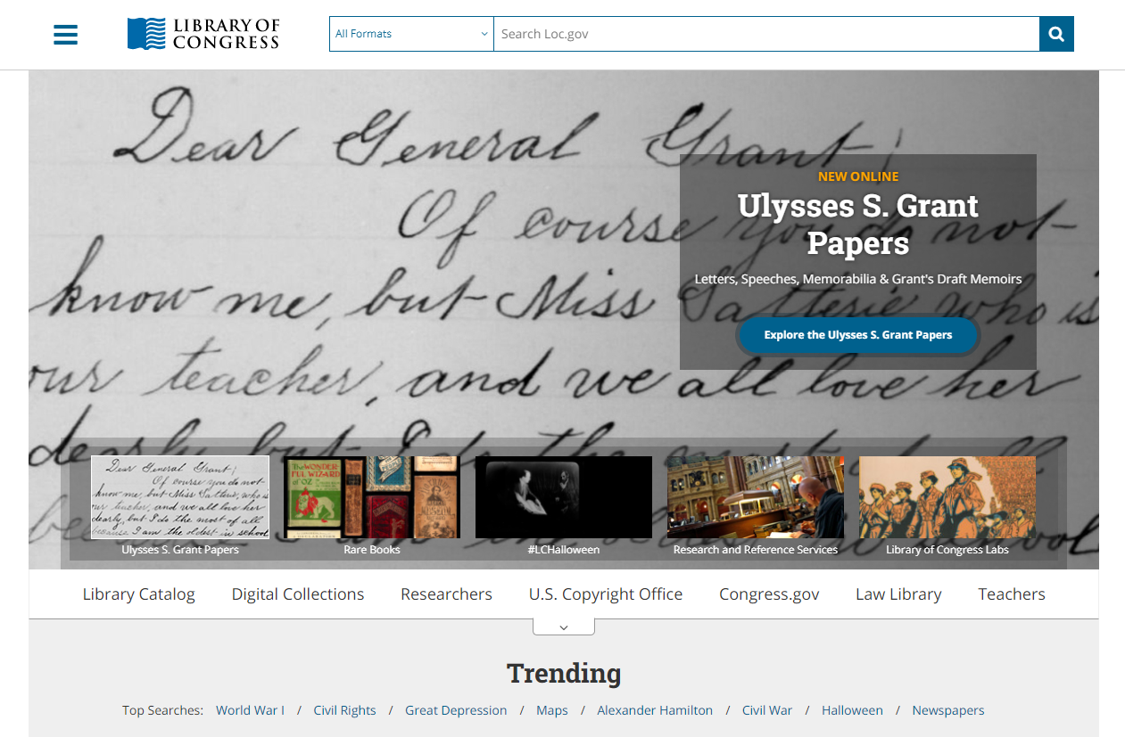
Suggested Resources loc.gov
Library of Congress

Slide 21
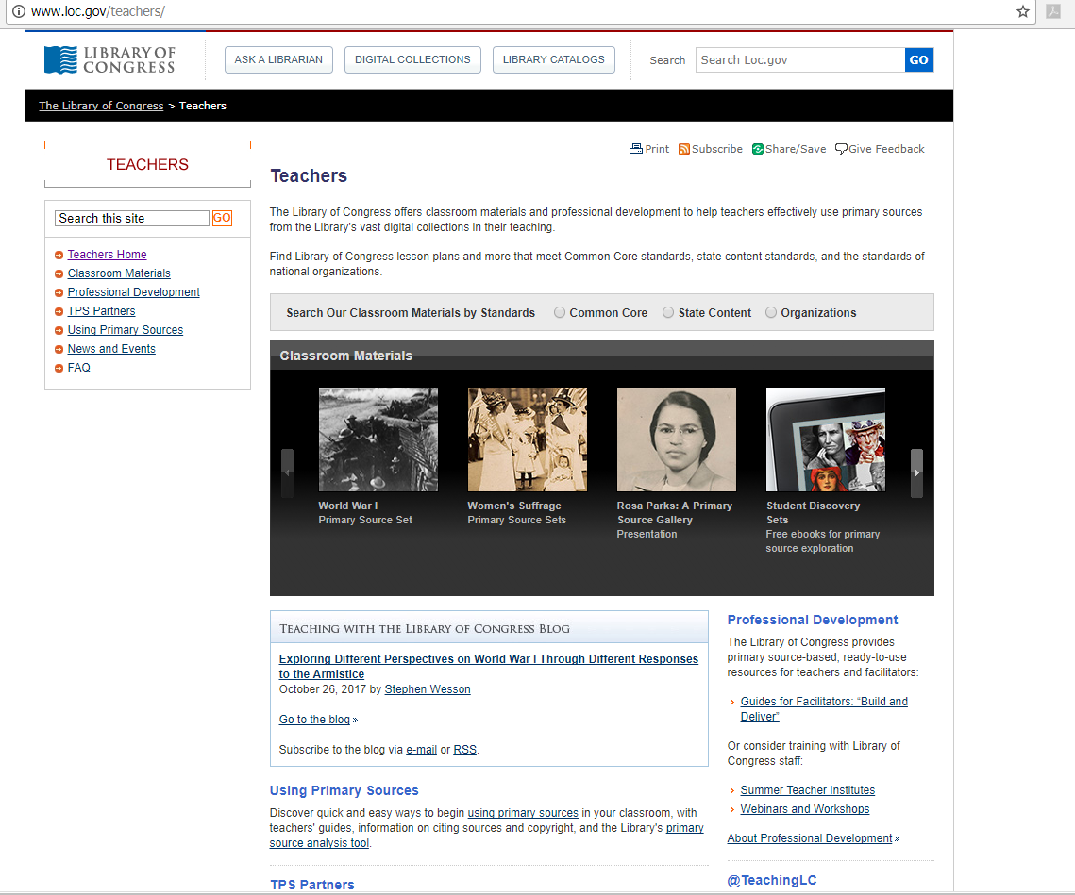
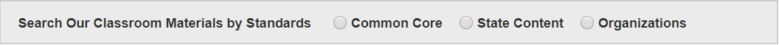
For teachers!

Slide 22
Example Lesson Plan
Child Labor and the Building of America

Slide 23
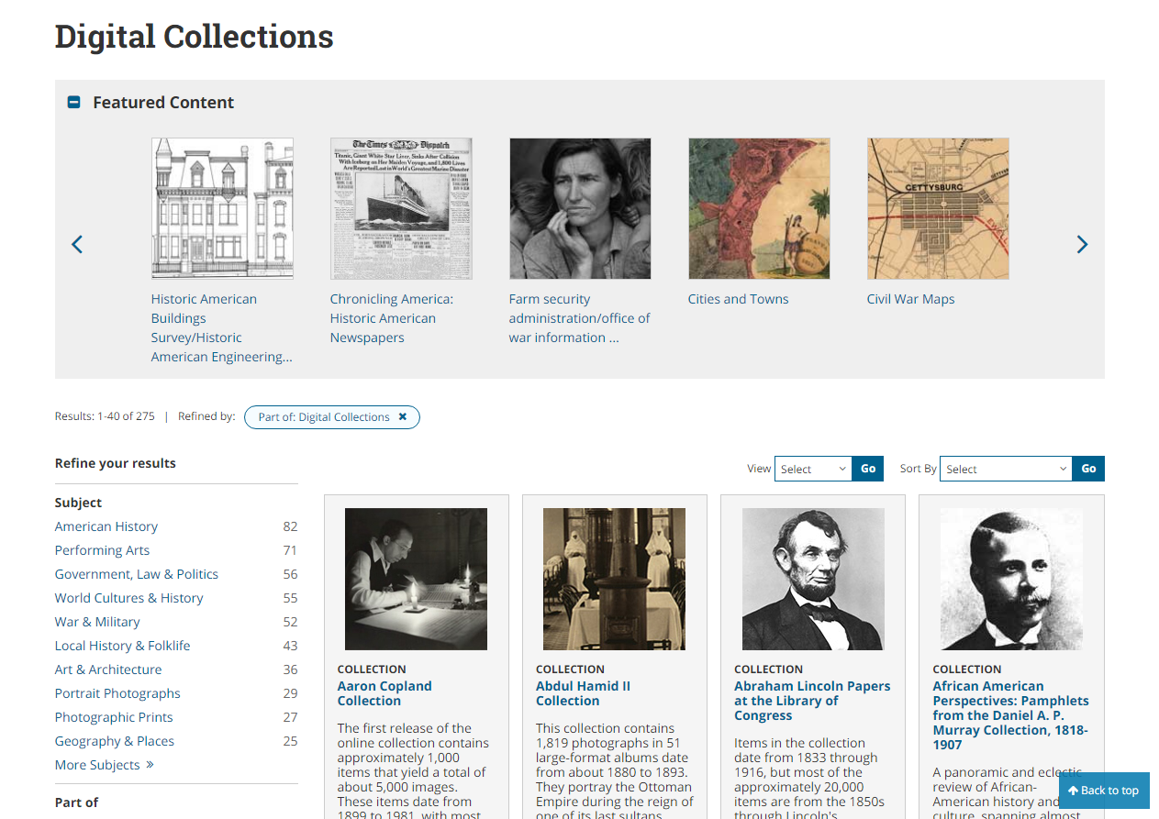
Check out the digital collections!

Slide 24
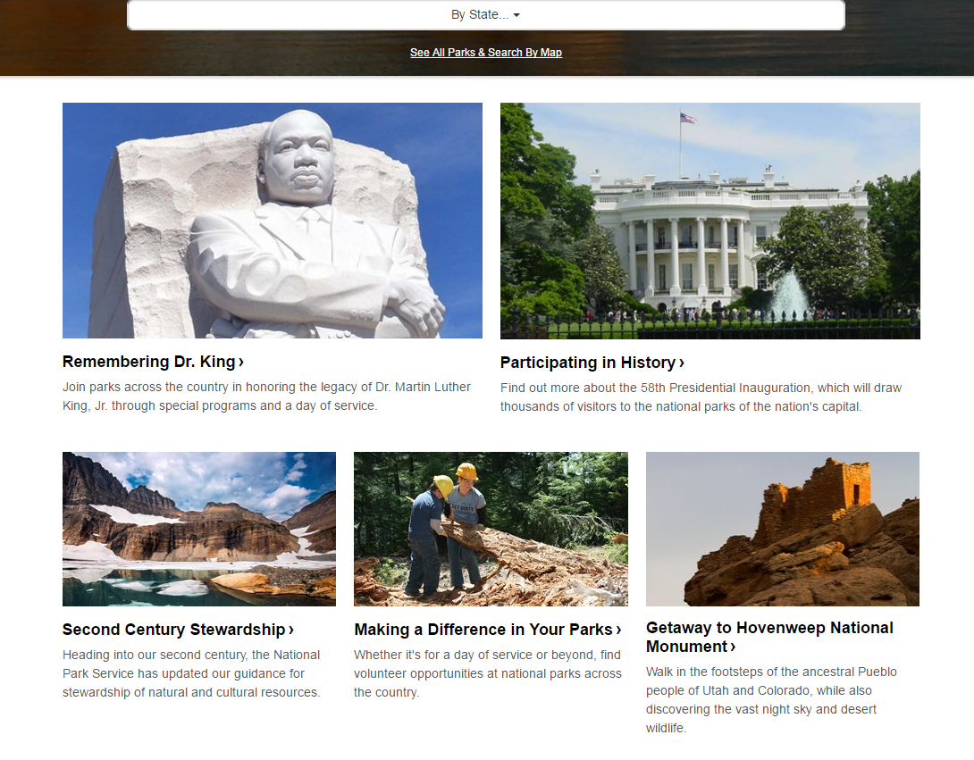
Suggested Resources nps.gov
National Park Service
Major figures in history often have historical sites throughout the United States

Slide 25
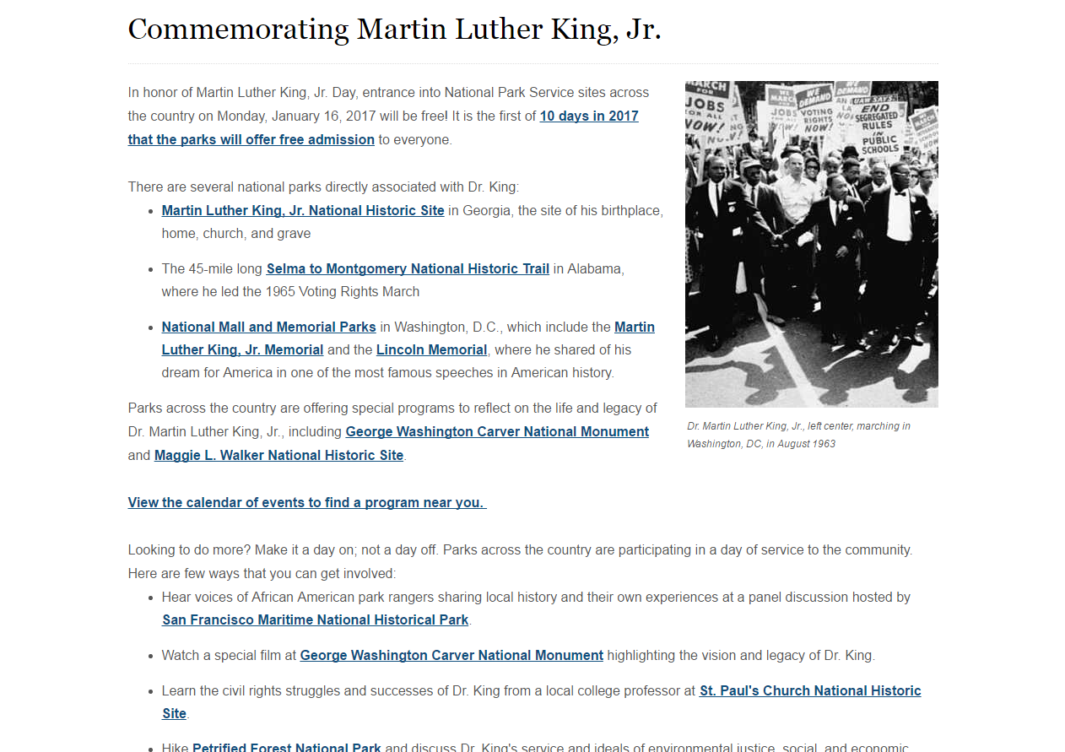
NPS
Check out all of these historical sites!

Slide 26
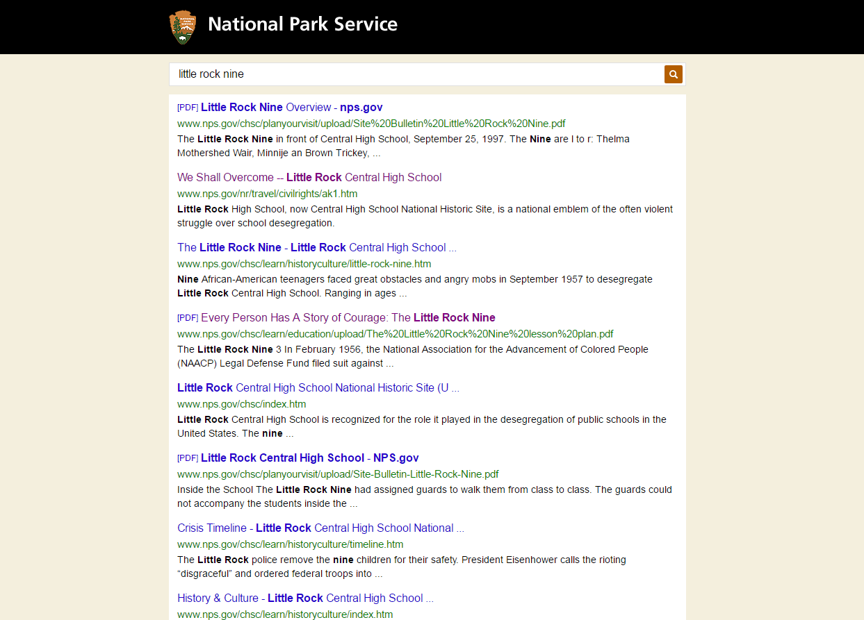
Do a search for your topic

Slide 27
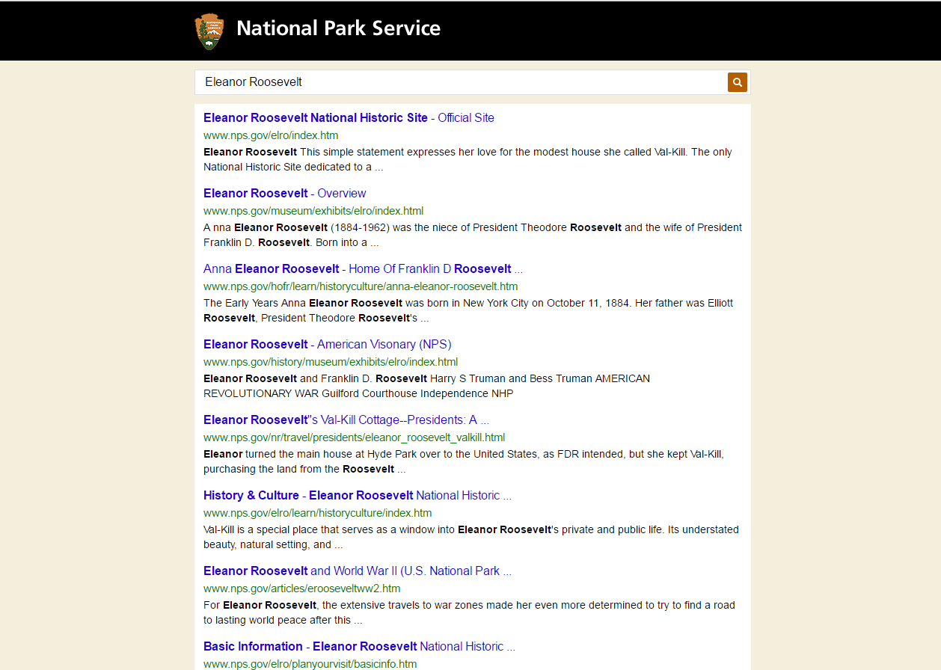

Slide 28
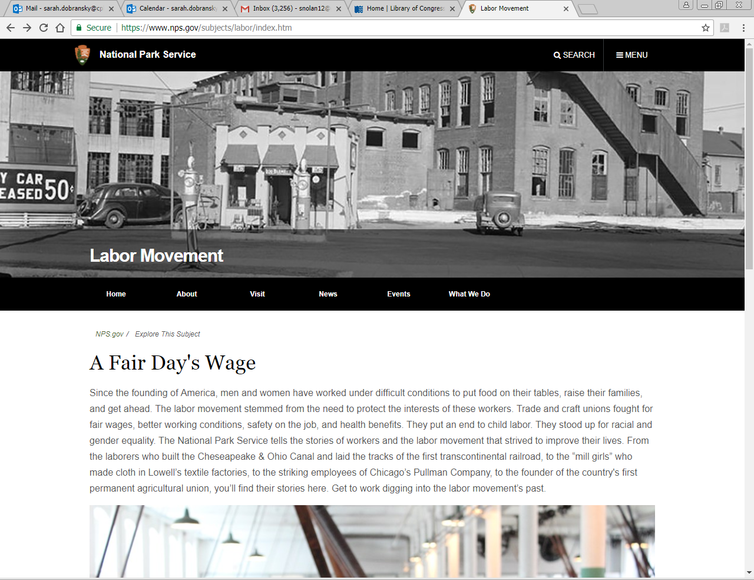
Example – labor movement

Slide 29
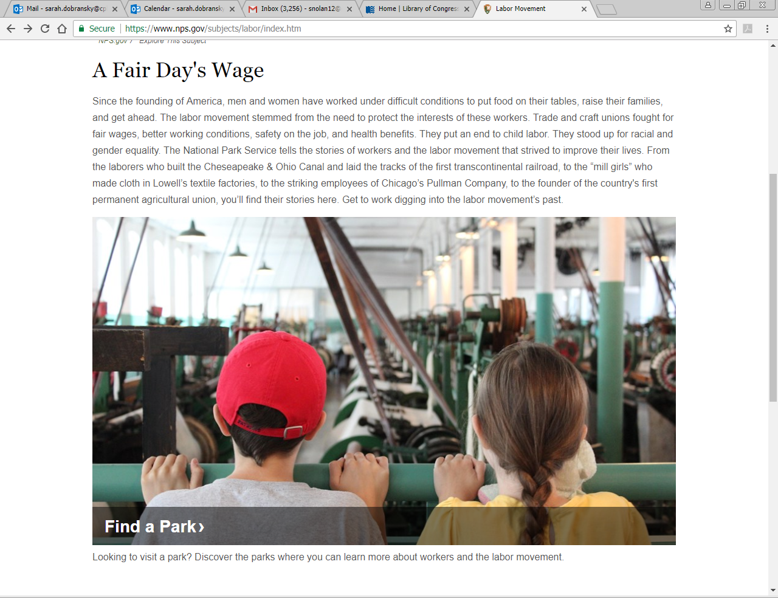

Slide 30
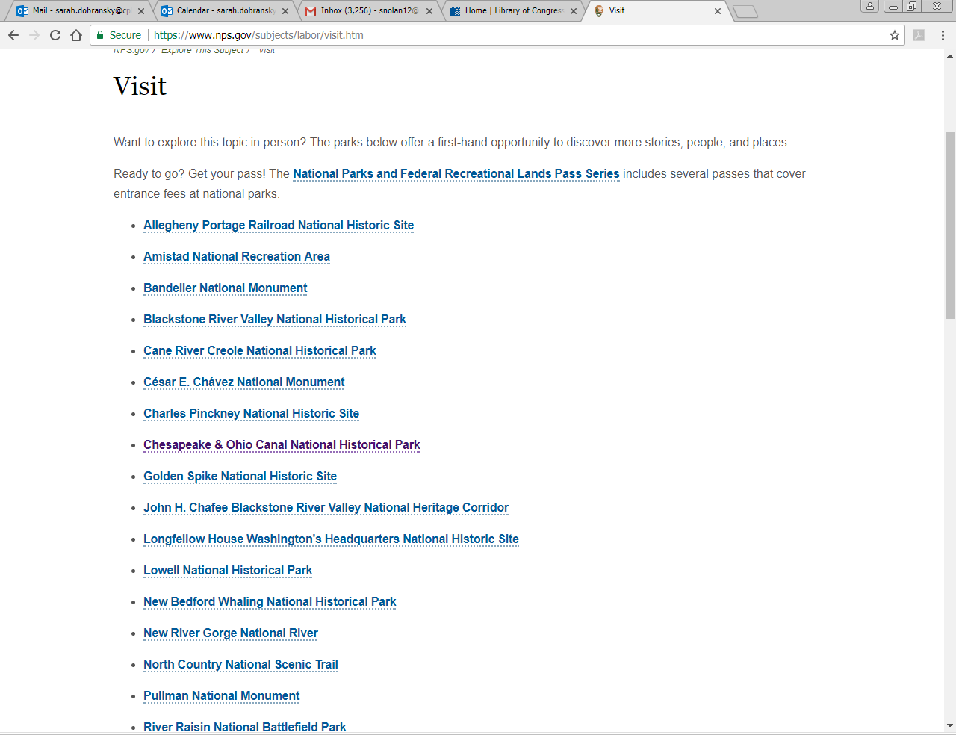

Slide 31
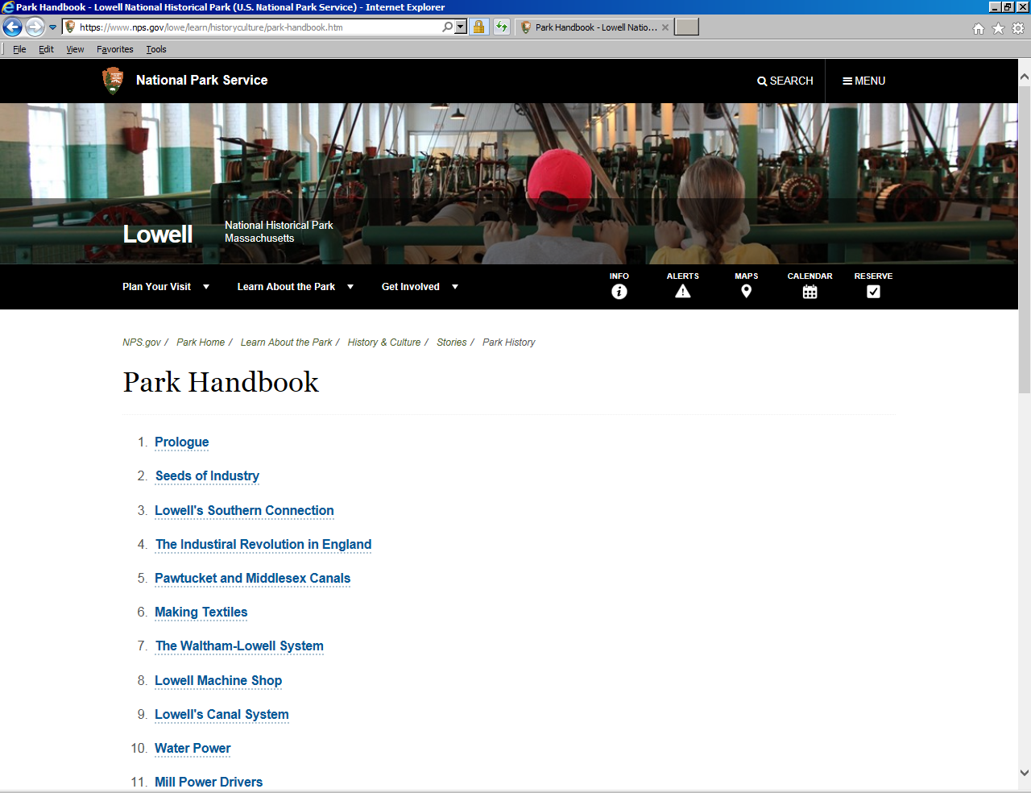
Lowell

Slide 32
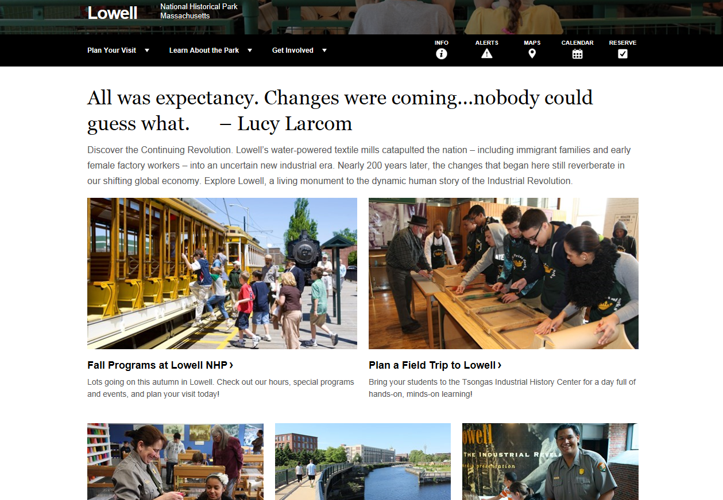
The park main page may not have the same links as the topic guide!

Slide 33
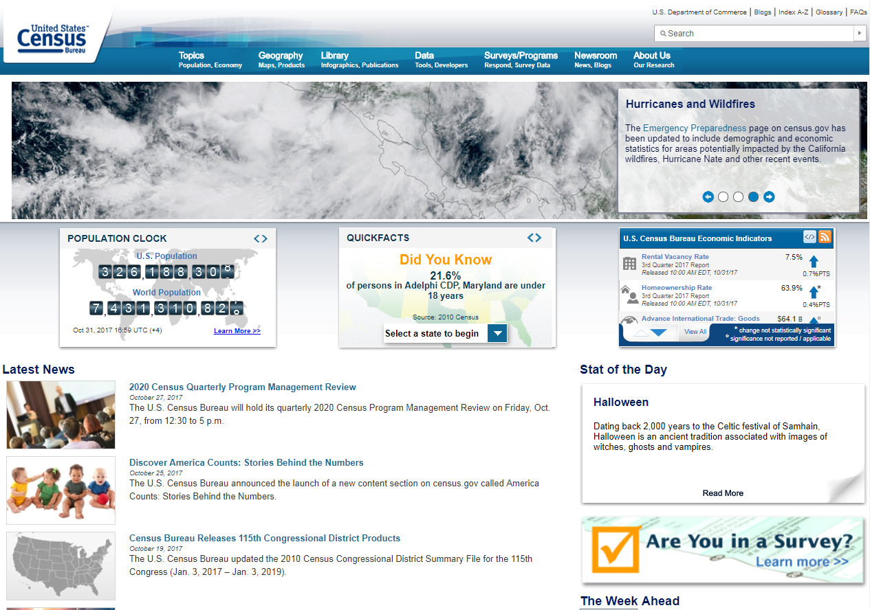
Suggested Resource: Census

Slide 34
Use Census data to watch the nation’s populations change
See how African American voting statistics changed after the Voting Rights Act of 1965
See how many women graduated from high school and later college after 1950 and again after 1950
Track African American population changes in the Great Migration
EXAMPLES
VOTING TRENDS IN AMERICA, 1964–2014
“I HAVE A DREAM” – LEARNING ABOUT MARTIN LUTHER KING JR.

Slide 35
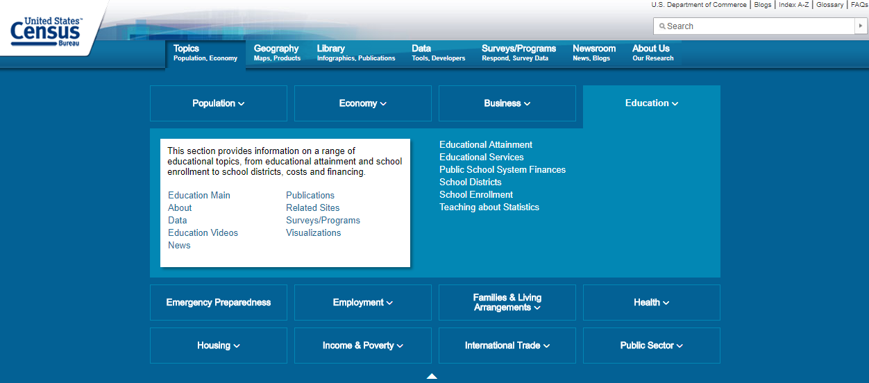
You may have to DIG!

Slide 36

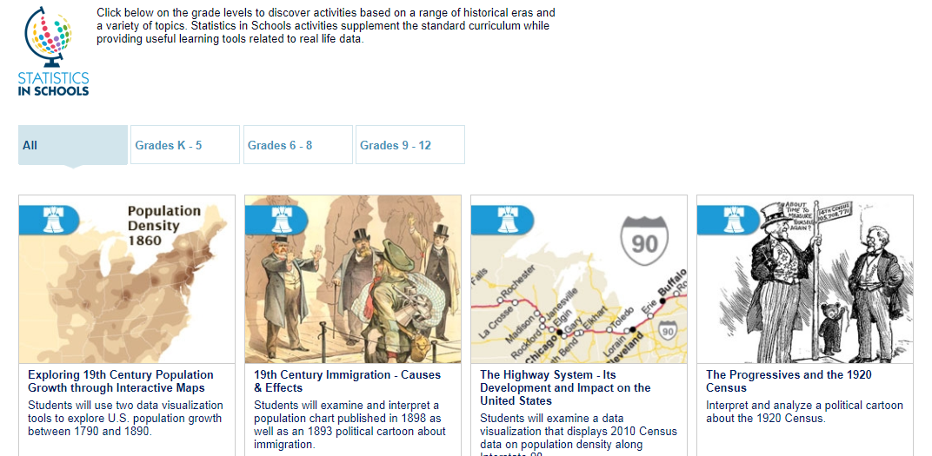
Statistics in Schools - Census

Slide 37
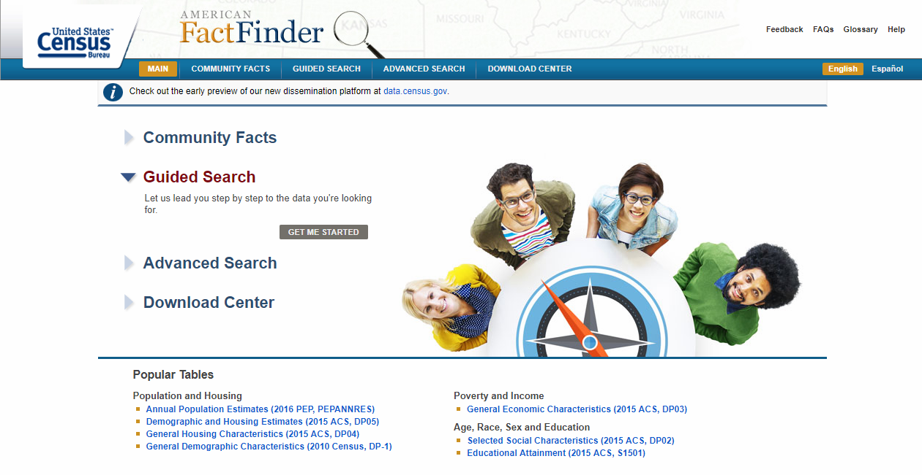
American Fact Finder

Slide 38
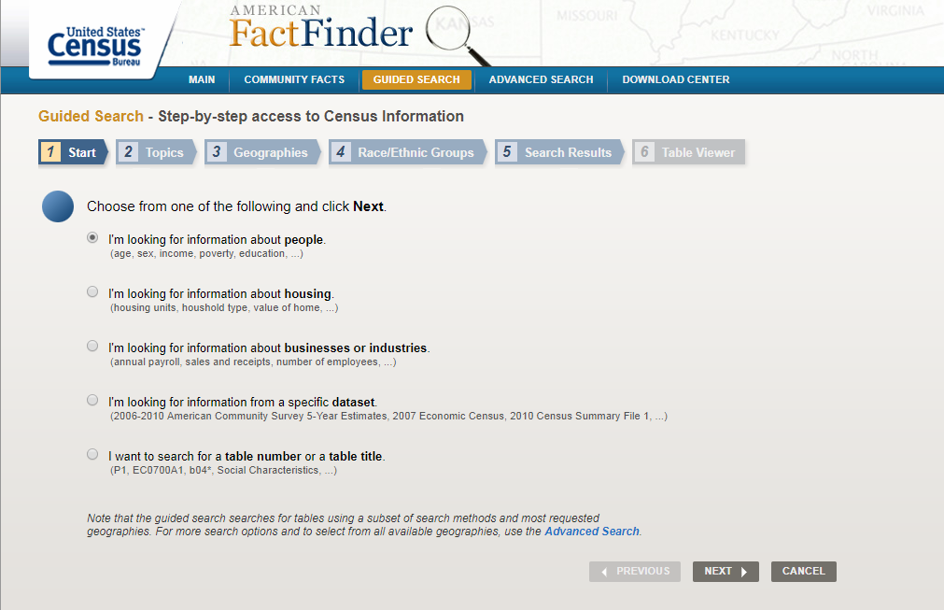
Build a table

Slide 39
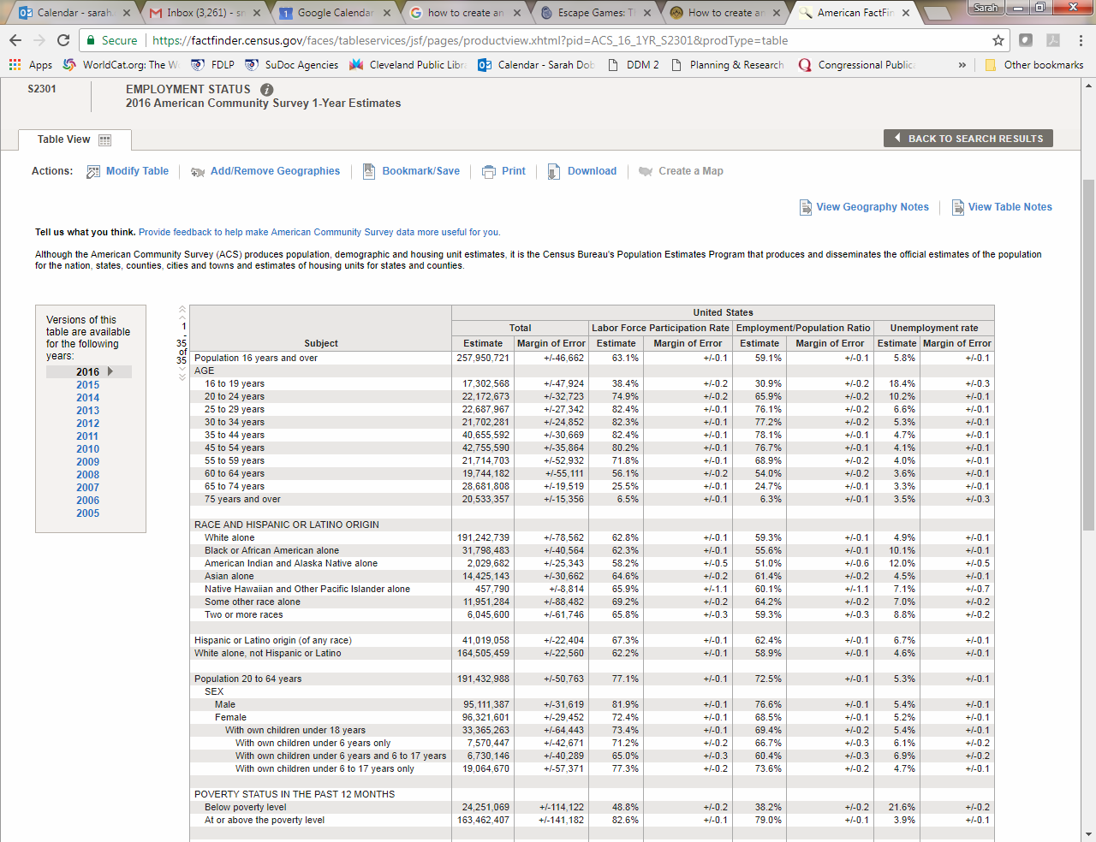

Slide 40
A new spin
Look at the famous laws that were the results of famous historical events (e.g. Civil Rights Act of 1964, the Thirteenth Amendment abolishing slavery)
See who introduced the laws; who influenced the legislation
What was said in Congress?
Take a look at the Congressional Record!
Resources:
Senate.gov – Civil War
Senate.gov – Civil Rights Act of 1964

Slide 41
Read between the lines
When looking at Congressional hearings, see who was listed as a witness
See if that person has any published works
See if the Congressional committee members have written anything on that topic
MANY bills are introduced in Congress, but few are actually considered by committee – narrow your results before jumping in!

Slide 42
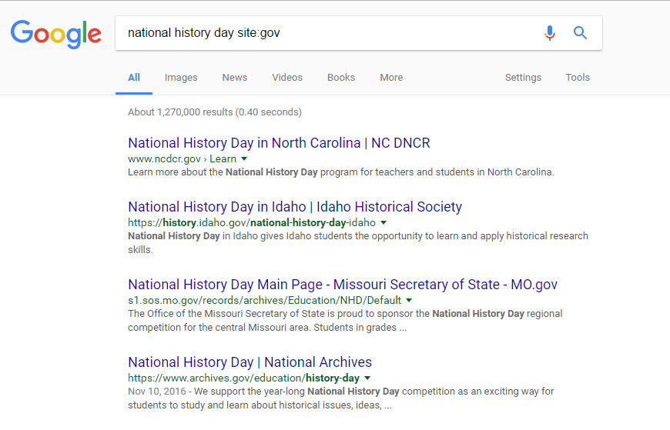
Getting government sites with Google
In a google search bar, use the phrase site:gov at the end of your search
Some results will be for state resources
Some results will be for national resources

Slide 43
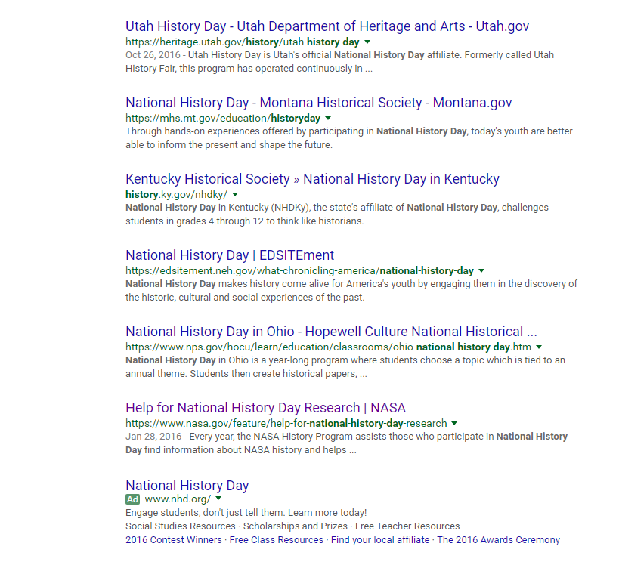
ABC’s of Government
Agencies
Bureaus
Commissions
Scroll down to see ALL the results. You never know what you’ll find!
NARA (National Archives and Records Administration)
Interior Department (National Parks)
Labor Department
NASA
National Science Foundation
Smithsonian Institute
Census Bureau
Remember! [Ad] means that the link isn’t part of your search results!

Slide 44
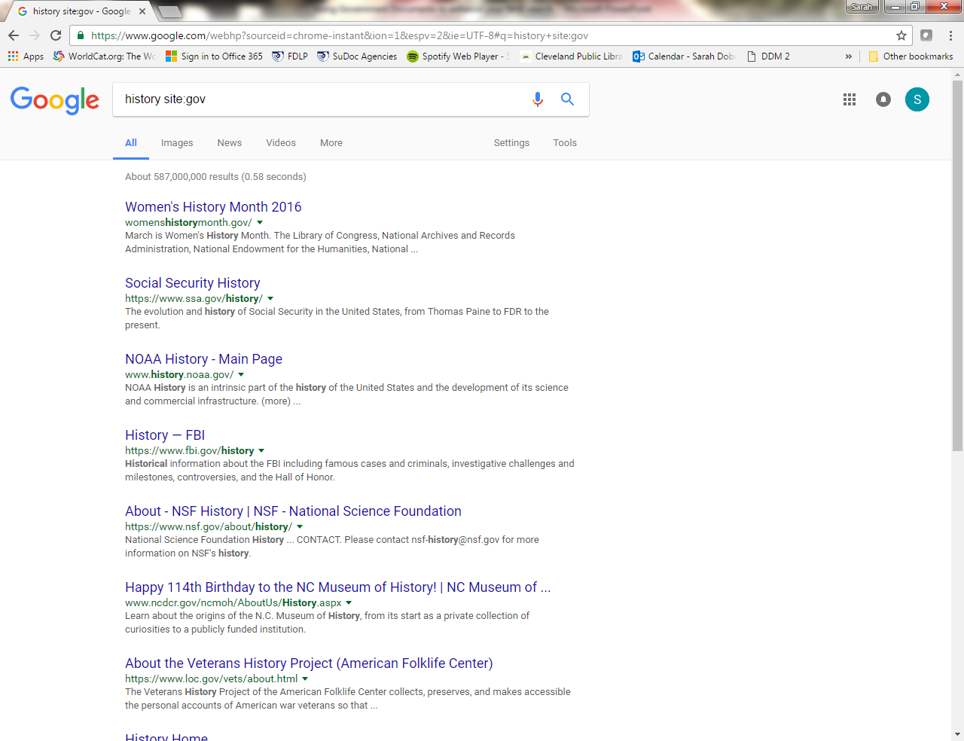
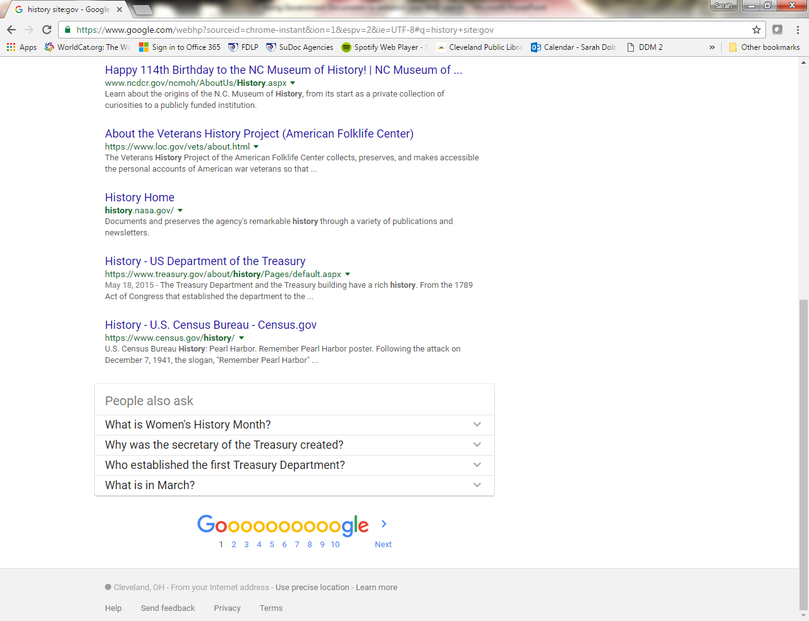
Search “history site:gov” to find the history page for government agencies

Slide 45
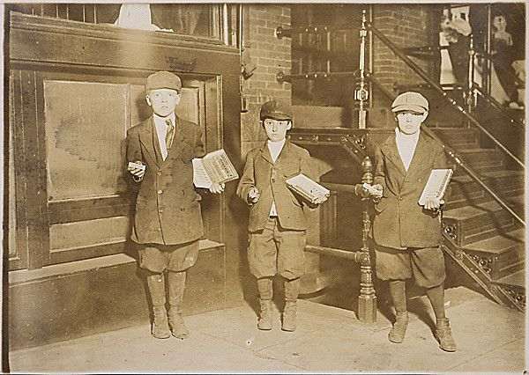
Example Topic: Rise of Labor Laws and Labor Unions
9 P.M. Gum vendors still selling, near the National Theater. Eli Marks, 8 years old, makes 25 cents a night. Morris Marks, 10 years old, makes 50 cents a night. Harry Schneider, 11 years old, makes 50
Photo on Docs Teach

Slide 46
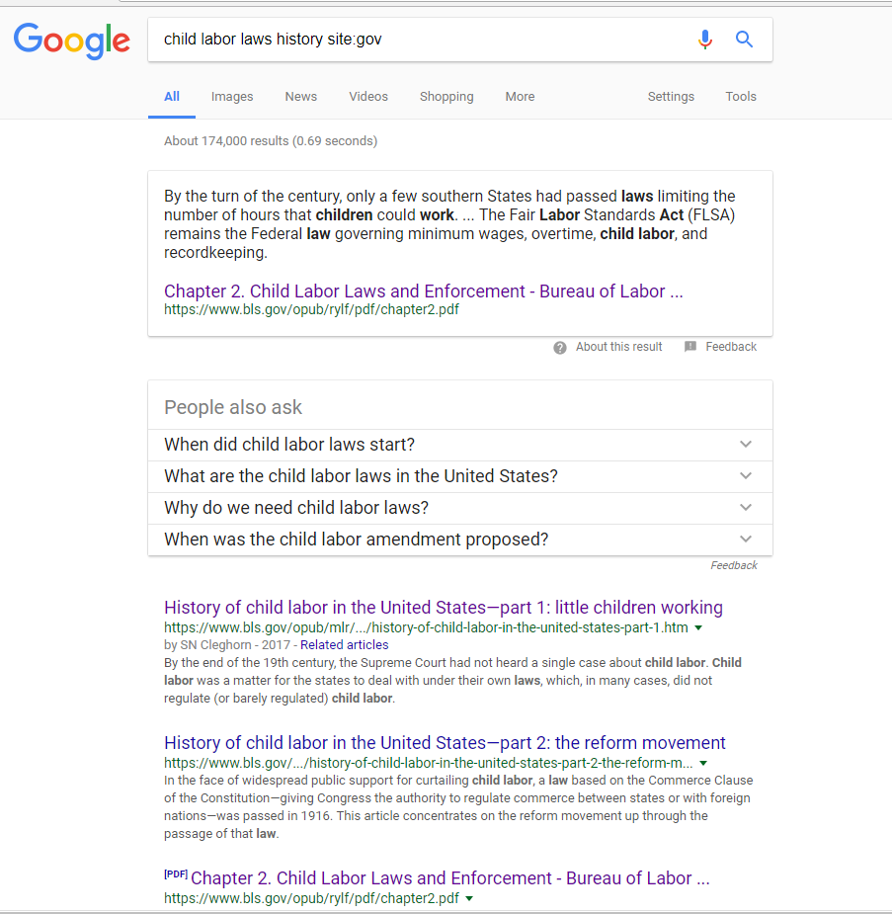

Slide 47
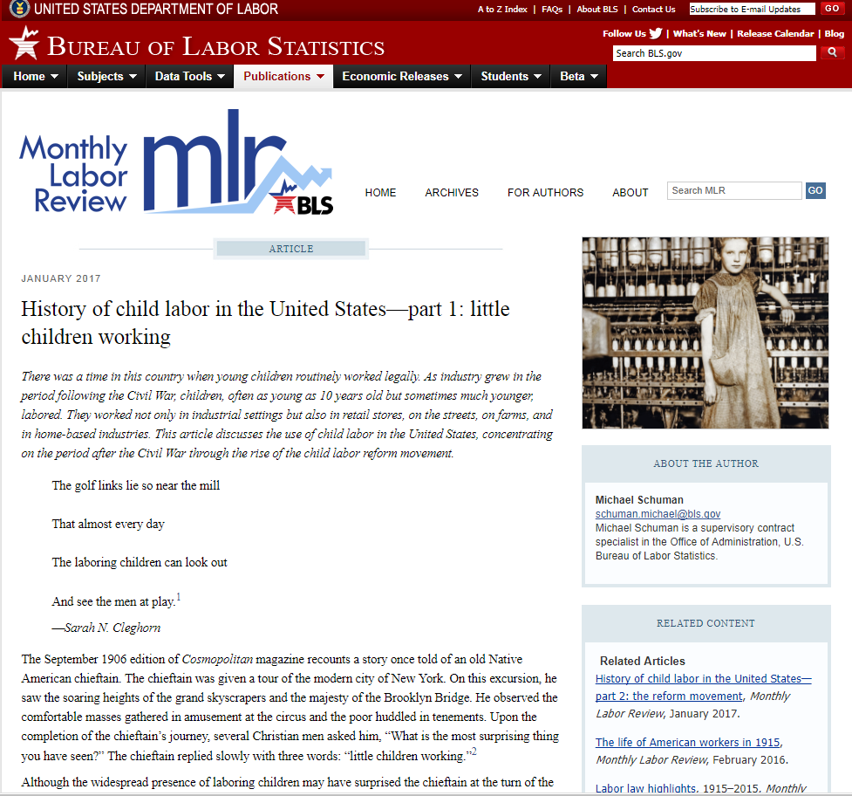

Slide 48
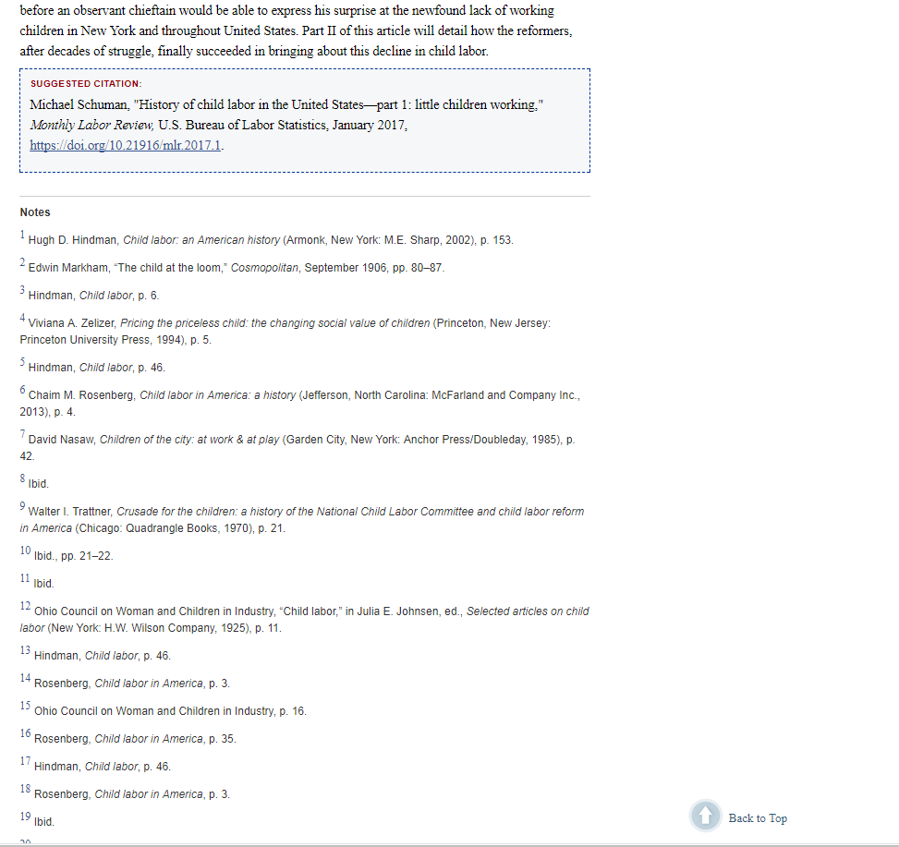

Slide 49
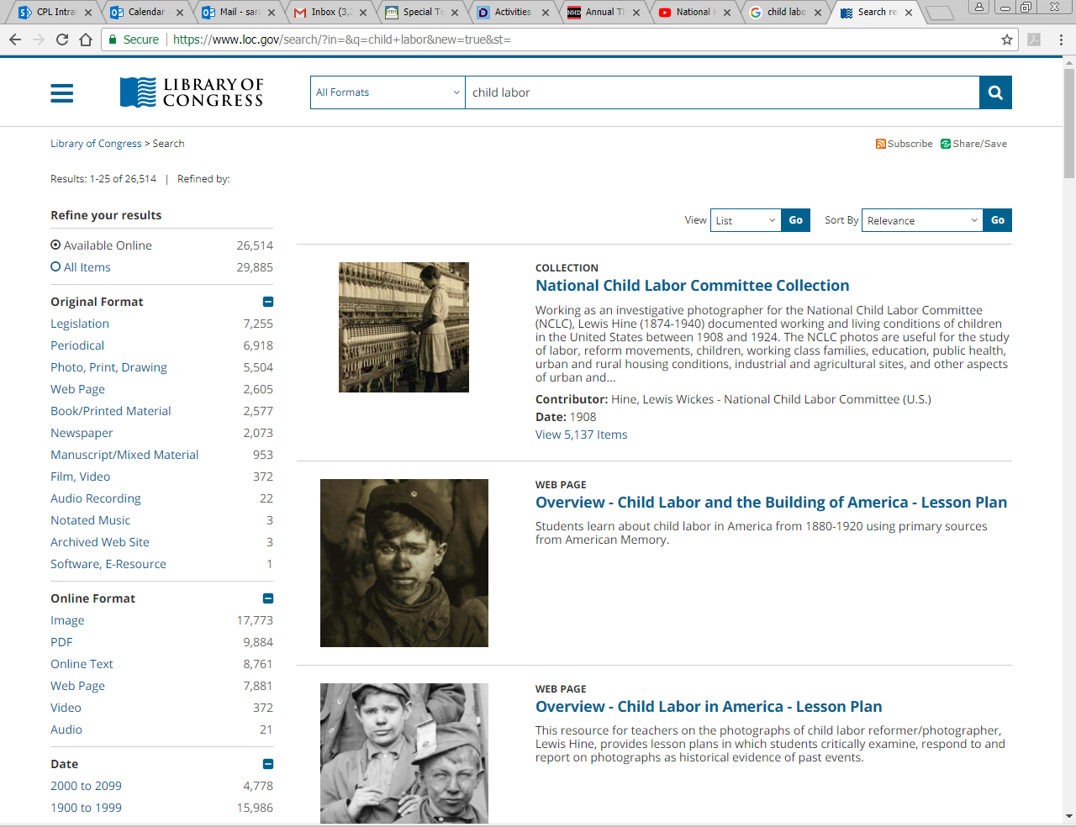

Slide 50
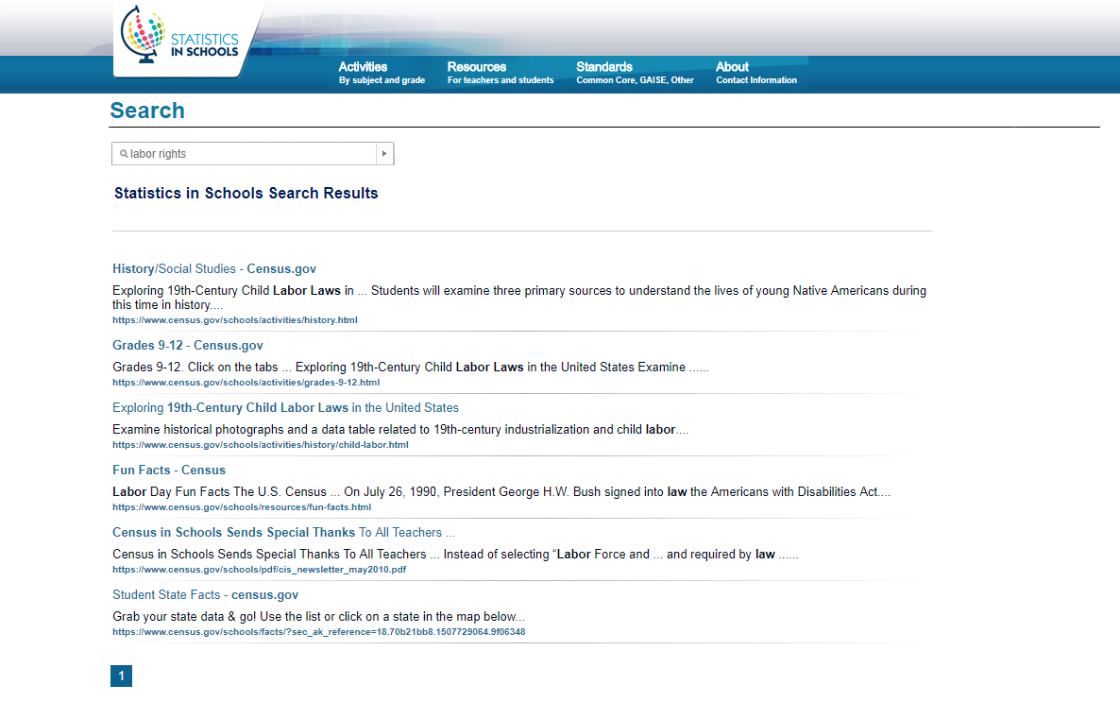

Slide 51
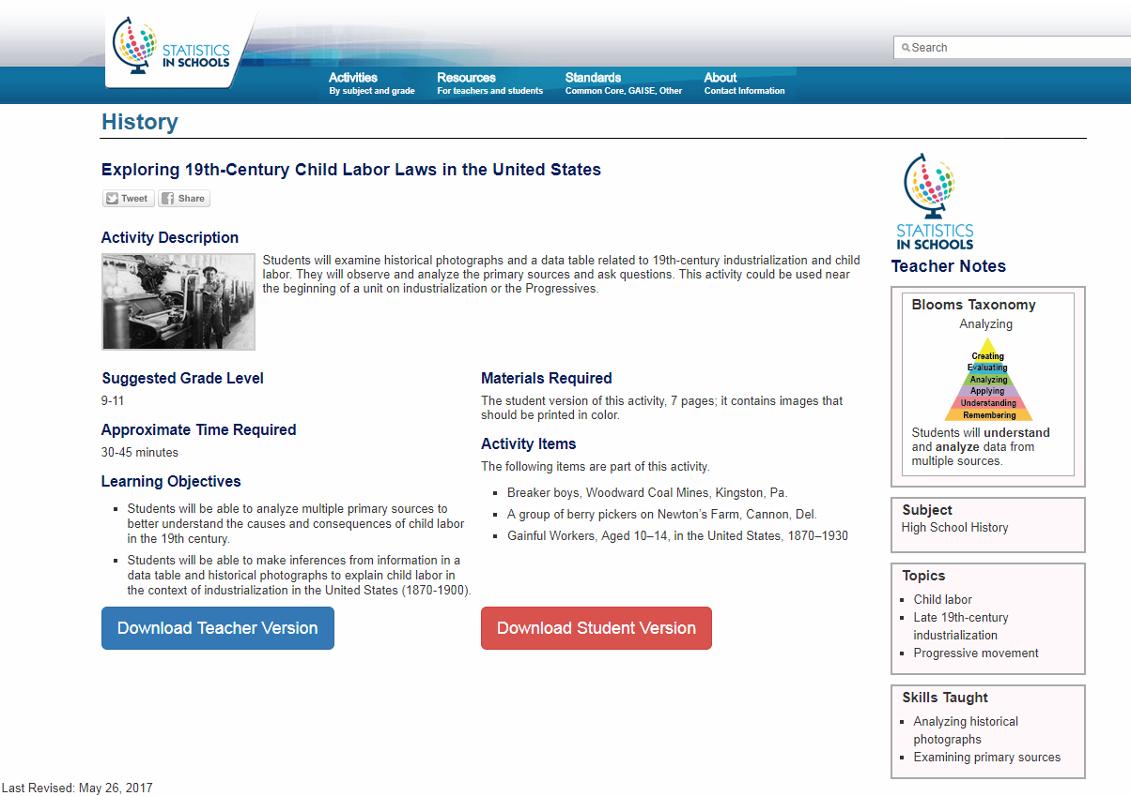
Click Here!

Slide 52
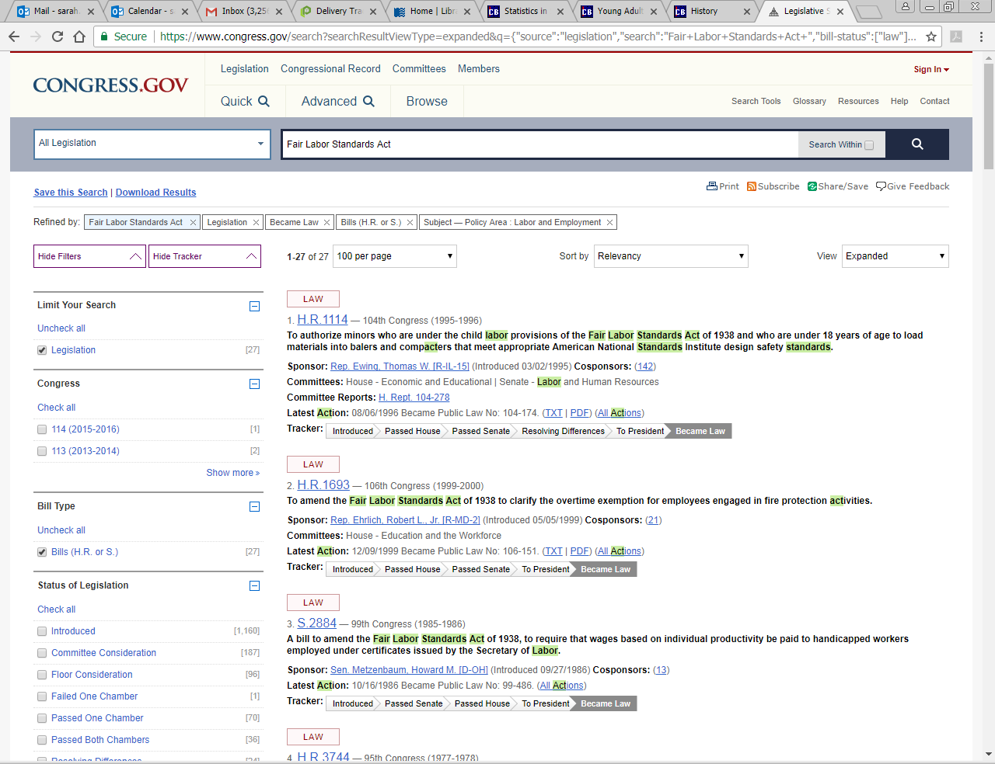

Slide 53
H.R.1114 - To authorize minors who are under the child labor provisions of the Fair Labor Standards Act of 1938 and who are under 18 years of age to load materials into balers and compacters that meet appropriate American National Standards Institute design safety standards. (1995)

Slide 54
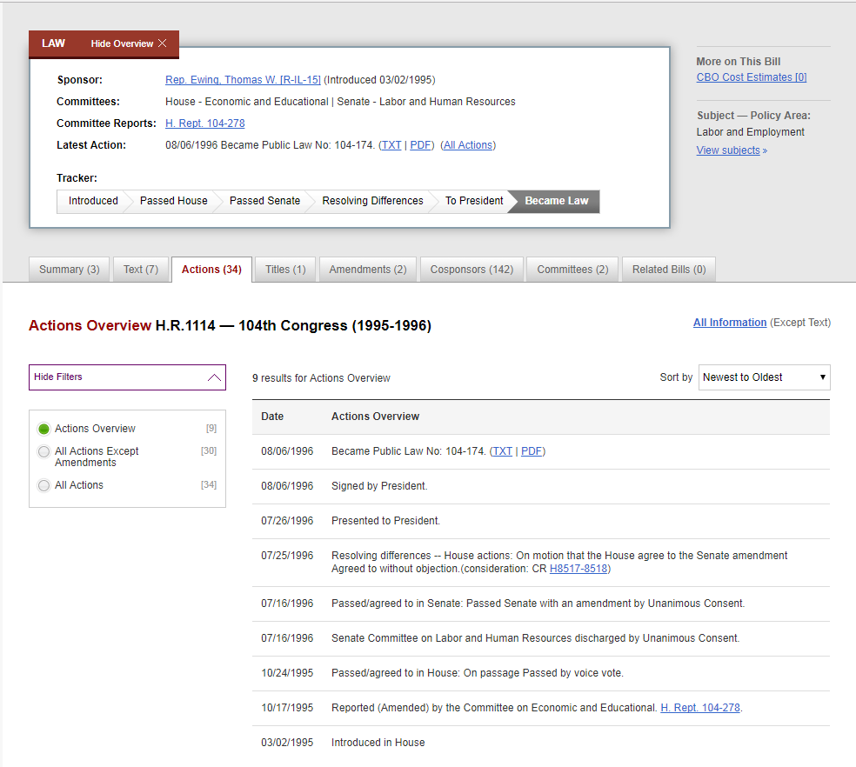
H. Rept. 104-278

Slide 55
Remember!
Government Documents are primary resources
You may have to dig a little for what you need
Use site:gov in your Google searches to narrow results
Don’t be afraid to think outside the box!
Remember to look at the agencies and see what they have

Slide 56
Questions?

