Slide 1
DISPLAY IN A BAG
Federal Depository Libraries
Display ideas

Slide 2

Place a poster in the center of your display
Use the new FDLP promotional poster available free from http://beta.fdlp.gov/order/
Use one of the suggestions that follow
Use your favorite GPO poster

Slide 3
Other poster suggestions
Discover Depository Libraries : take the mystery out of finding government information
GP 3.21/2:D44/3/large
Ben Franklin wants you to read your government publications
GP 3.21/2:B43
Information for everyone
GP 3.21/2:In3/3

Slide 4
FREE GOVERNMENT INFORMATION
The Federal Government publishes laws and regulations, Congressional hearings and reports, statistics and information of interest to you as a consumer, ALL AVAILABLE TO YOU FREE ONLINE OR AT A FEDERAL DEPOSITORY LIBRARY.
Add your library information here.

Slide 5
GENEALOGY
Serial Set volume of the War of the Rebellion
Use an actual volume or printout of a title page W 45.5:

Slide 6
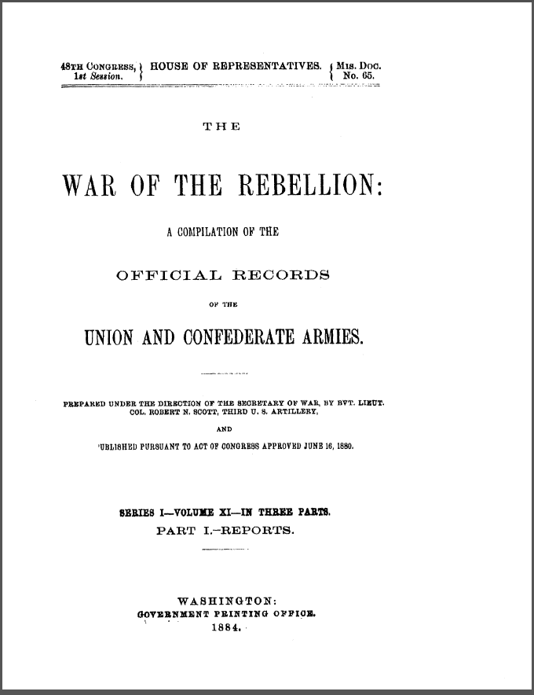

Slide 7
DRUG SAFETY
Buying prescription medicine online : a consumer safety guide
HE 20.4002:M 46/21
http://purl.access.gpo.gov/GPO/LPS114409
Objects to add: empty prescription bottles (with name label removed).

Slide 8


Slide 9
FISH & WILDLIFE
Conserving the future : wildlife refuges and the next generation
I 49.2:C76/21
http://purl.fdlp.gov/GPO/gpo19337

Slide 10


Slide 11
COMMERCE
Intellectual property and the U.S. economy : industries in focus
C 21.2:IN8/4
http://purl.fdlp.gov/GPO/gpo25619

Slide 12


Slide 13
GOVERNMENT SALES
A guide to finding government property for sale
online only at http://www.govsales.gov/html/PublicBrochure.pdf

Slide 14


Slide 15
MILITARY HISTORY
Quantico, crossroads of the Marine Corps
D 214.13:Q2/2008
paper only from GPO
online from US Marine Corps
https://www.mcu.usmc.mil/historydivision/

Slide 16


Slide 17
CONSUMER PRODUCT SAFETY
The safe nursery : bright ideas for keeping your baby’s nursery safe
Y 3.C 76/3:2 N93/2
http://purl.access.gpo.gov/GPO/LPS119652
Objects to add: rattle, night light, pacifier, something baby related.

Slide 18


Slide 19
MEDICARE & MEDICAID
Guide to choosing a nursing home
HE 22.8/24:
http://purl.access.gpo.gov/GPO/LPS28407

Slide 20


Slide 21
NOAA
Weather spotter’s field guide : a guide to being a SKYWARN spotter
C 55.108:SP 6/4
http://purl.fdlp.gov/GPO/gpo11809
Object to add: binoculars

Slide 22
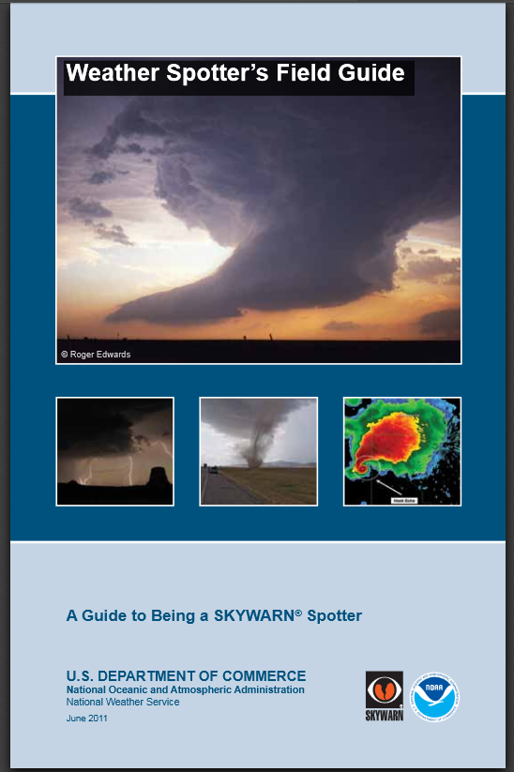

Slide 23
FOOD AND DRUG ADMINISTRATION
To your health! : food safety for seniors
HE 20.4002:H 34/5 paper only
Available online through Hathi Trust

Slide 24


Slide 25
OTHER SOURCES FOR IDEAS
The Government Documents Display Clearinghouse at http://lib.mnsu.edu/govdoc/finalfront2.html
Federal Documents Display in a Bag is meant to be a guide. Feel free to make substitutions.

Slide 26

Contact Information
Audrey L. Hall
Library Consultant
The State Library of Ohio
274 E. First Ave.
Columbus, OH 43201
614-995-0033
ahall@library.ohio.gov
May 6, 2013

